Slide 1


Coronavirus disease outbreak prediction and analysis using machine learning techniques
Supervised by
Mr. Emam Hossain
Assistant Professor
Department of Computer Science & Engineering
Ahsanullah University of Science & Technology

Slide 2







Presented By
Simanta Sarker
ID: 180104010
Jain Jannath
ID: 180104023
Arifa Akter
ID: 180104050
Mehedi Hasan
ID: 180104132

Slide 3





Introductions
1
2
Coronavirus (COVID-19), a global pandemic of today's era
Havocking on the economy and society
3
4
Impacting on people of all ages, creating severe diseases
Innovative methods, for analyzing the Covid-19 data

Slide 4







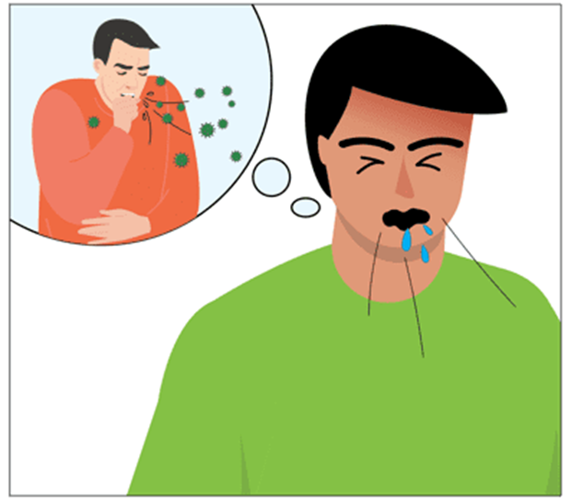

Motivations
06
MM
Suppling medical equipment and other things is still difficult
Many governments proclaimed lockdown
Impact on economy
Million of deaths

Slide 5

Objectives
01
02
03
04
05
Predict the future situation of COVID-19
Raise awareness and identify infection
Control the rapid spread of Coronavirus disease
Ensuring fast identification of cases
Anticipate the result of affected, death with COVID-19

Slide 6


Literature Review
6

Slide 7
Summary Table
Papers | Datasets | Methods | Results
[1] | The official COVID-19 reported cases in Russia and Brazil | • ANFIS • CMPA • PSO | • CMPA has the best accuracy among all models • CMPA-ANFIS model has a limitation in the computational time, which is not faster than the PSO.
[2] | Epidemical dataset from Johns Hopkins University’s Coronavirus Resource Center. | • Multi-head attention based method (ATT BO) • CNN-based method (CNN BO) • LSTM-based method (LSTM BO) | The three proposed methods perform significantly better than the benchmark model in terms of all overall measures such as Mean SMAPE, Rank SMAPE, Mean MAPE, Rank MAPE, Mean RMSE, and Rank RMSE.
[3] | • European Centre for Disease prevention and Control (ECDC) data for different coronavirus Trends • Google trends data | ARIMA • LSTM • Grey Wolf Optimization | The proposed model performs better.
7

Slide 8
Papers | Datasets | Methods | Results
[4] | Dataset of Bangladesh (Government Official source) | • Prophet • ARIMA | The ARIMA performs better.
[5] | Our World in Data by Hannah Ritchie. | • Robust Fitting • Gaussian • Beta(4-parameter) • Fisher-Tippet (Extreme Value distribution) • Log Normal | Iterative fitting of the Inverse Weibull distribution outperforms iterative fitting of other distributions
[6] | From the Center for Systems Science and Engineering at Johns Hopkins University’s GitHub repository. | • Linear Regression • Least Absolute Shrinkage and Selection Operator • Support Vector Machine • Exponential Smoothing | ES outperforms all other models, while LR and LASSO perform equally well.
[7] | The Covid-19-India and Covid 19-Data datasets are used. | • Support Vector Machine, XGBoost Classifier • KNN+NCA • Decision Tree Classifier, Random Forest Classifier • Gaussian Nave Bayesian Classifier • Multilinear Regression, Random Forest Regressor • Logistic Regression | The Random Forest Classifier and Random Forest Regressor outperformed the other ML Models.

Slide 9
Papers | Datasets | Methods | Results
[8] | Dataset of 10 countries (Our World in Data by Hannah Ritchie) | • Auto-Regressive Moving Average, Holt-Winter Exponential Smoothing • Auto-Regressive Integrated Moving Average • Support Vector Regressor ,Linear Regression, Bayesian Ridge Regression • Linear Regressor, Extreme Gradient Boost Regressor • Polynomial | ARIMA provided an accuracy of over 85% in the majority of cases.
[9] | Dataset was taken from COVID19- India API Organization. | Linear Regression (LR) • Decision Tree • Least Absolute Shrinkage and Selection Operator (LASSO) • Random Forest • Support Vector Machine (SVM). | • Random forest and polynomial LR provide a superior outcome for Active Cases. • For Death rate, Poly LASSO and poly LR shows the next best result. • For Recovery rate, Poly LR produces the greatest results.
9

Slide 10
Papers | Datasets | Methods | Results
[10] | Dataset was taken from John Hopkins University | Polynomial Regression, Support Vector Regression | SVR performs better .
[11] | Dataset of Bangladesh (Our world in Data) | Linear Regression Models, k-nearest neighbors (KNN) | k-nearest neighbors (KNN) perform better
[12] | Dataset provided by John Hopkin University | •Linear Regression •Polynomial Regression •Support Vector Regression •Auto Regressive Model •Moving Average Model •Holt's Winter Additive Model •Auto Regressive Integrated Moving Average Model •Prophet Model | Prophet Model gave the best accuracy
10

Slide 11
Papers | Datasets | Methods | Results
[13] | • Collected from IDCR • Contains daily reports and time series sequential Tables | • Long Short-Term Regression • Random Forest Regression • Support Vector Regression | • For LSTM – Accuracy 65.83 (Confirmed cases) – Accuracy 2.95 (Death cases) – Accuracy 163.21 (Recovery cases) • For RFR – Accuracy 184.21 (Confirmed cases) – Accuracy 3.28 (Death cases) – Accuracy 170.15 (Recovery cases) • For SVR – Accuracy 166.15(Confirmed cases) – Accuracy 4.73 (Death cases) – Accuracy 215.08 (Recovery cases)
[14] | Dataset of Mexico (Mexico’s General Directorate of Epidemiology) | • Decision tree Artificial Neural Network • Logistic regression Naïve Bayes Support Vector Machine | • The model developed with decision tree happened to be the best model among all models developed in terms of accuracy with 94.99%.
11

Slide 12
Papers | Datasets | Methods | Results
[15] | Obtained from the Saudi Ministry of Health’s official website | • Autoregressive Integrated Moving Average (ARIMA) • Autoregressive Model, Moving Average, a mixture of both (ARMA) and integrated ARMA (ARIMA) | ARIMA model’s prediction approaches outperformed the other models
[16] | Dataset used for this Research is taken from two websites COVID19 India and the Government of India’s website | • Polynomial Regression • Decision Tree Regression • Random Forest Regression | The Polynomial Regression model of degree 2 is the best suitable algorithm for predicting the number of discharge patients and for the prediction of total deaths, Random Forest Algorithm shows a little bit better performance than the decision Tree Algorithm.
[17] | From the Badan Nasional Penanggulangan Bencana (BNPB) | Logistic Regression Model | • MAE (2%) • MSE (0%) • R-SQUARE (99%)
12

Slide 13
Papers | Datasets | Methods | Results
[18] | Time series datasets of cumulative confirmed cases and cumulative deaths due to Covid-19 for 9 countries. | • Random Forest • K-nearest Neighbor • Support Vector Regression • ARIMA • SARIMA • Decision Trees • Holt Winter Model • Polynomial Regression • Gradients Boosting Regressor | The Holt’s winter ARIMA and SARIMA models have achieved the optimal models regarding the MAPE, MAE, and RMSE criteria
[19] | Contains record of 5644 patients collected from “Albert Einstein Israelita Hospital located” | • K-Nearest Neighbor ,PART • Radial Basis Function,Multi-Layer Perceptron • Naive Bayes ,Random Forest • K Star ,Suppoer Vetcor Machine | • Highest accuracy achieved during training is 100% by three algorithms KNN, k Star, and RF. • In testing, the maximum accuracy achieved is 88% by One R.
[20] | COVID-19 kaggle dataset for India | • Linear Regression • Multilayer Perceptron • Vector • Auto regression | MLP method is giving good rediction results than that of the LR and VAR method using WEKA and Orange.
13

Slide 14



Tools
1
Use Python as programing language
2
Use Google Colab as software
07

Slide 15
Holt Winters
1
2
3
4
Predict the behavior of a sequence of values over a time series
Powerful prediction algorithm
Work with trend and seasonality
Exponentially decreasing in relation to the historical data

Slide 16
Auto-Regressive Integrative Moving Average(ARIMA)
1
2
3
4
Autoregressive integrated moving average Model
Using
the public single-direction time request on a periodic basis
Time series analysis for modeling and forecasting
Predict future values based on past values.

Slide 17
Extreme Gradient Boosting (XGBoost)
1
2
3
4
Optimizes the training for Gradient Boosting
An implementation of Gradient Boosted decision trees
Provides parallel tree boosting
Capability to handle missing values

Slide 18
Facebook Prophet
1
2
3
4
An open-source algorithm
An additive regression model.
Three main model components: trend, seasonality, and holidays
Ability to make time series predictions with good accuracy

Slide 19

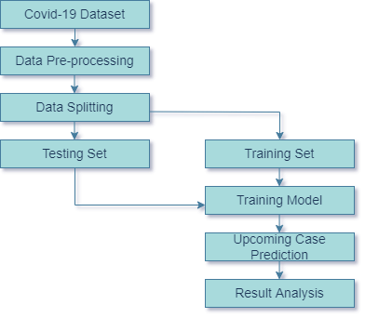


Methodology
19

Slide 20
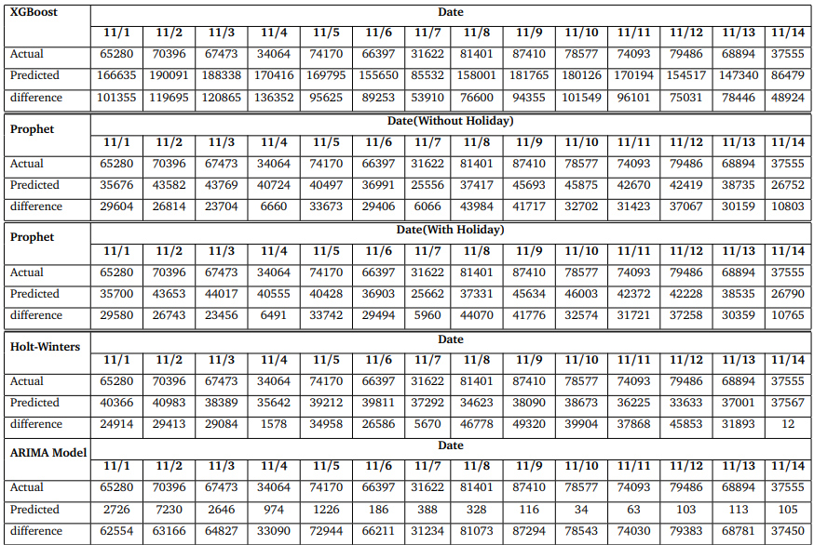
Result Analysis
Table 1:New infected confirm cases prediction by time series Model for the upcoming 14 days(JAPAN).

Slide 21
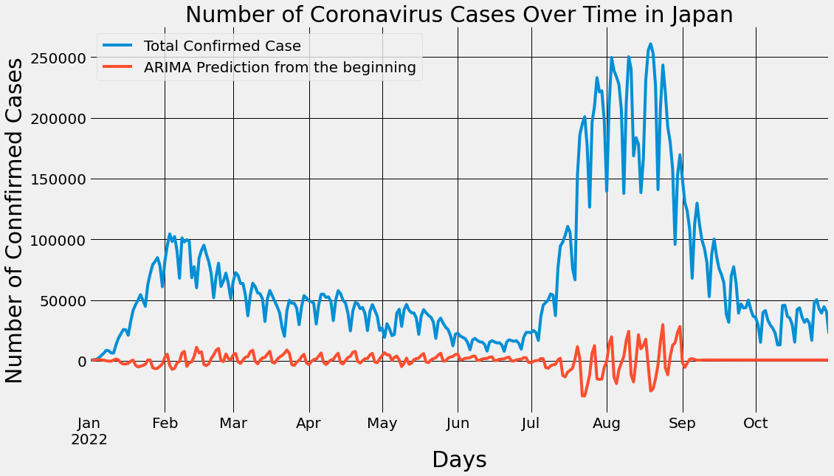
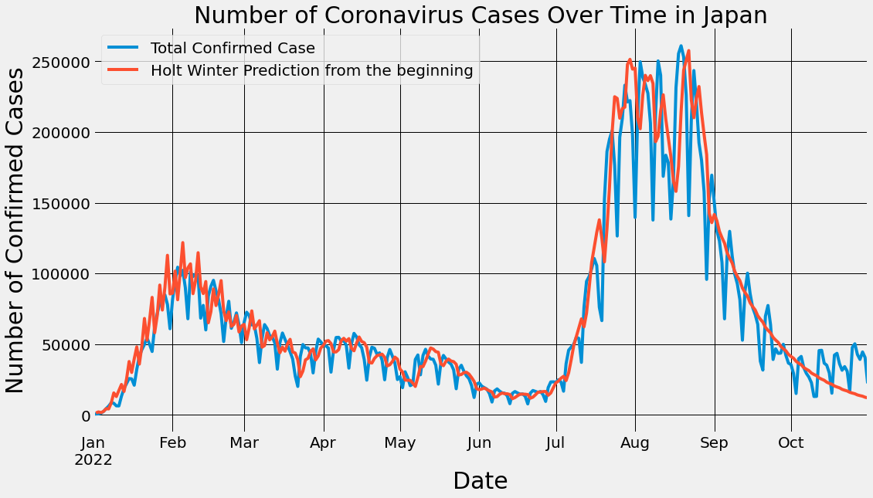
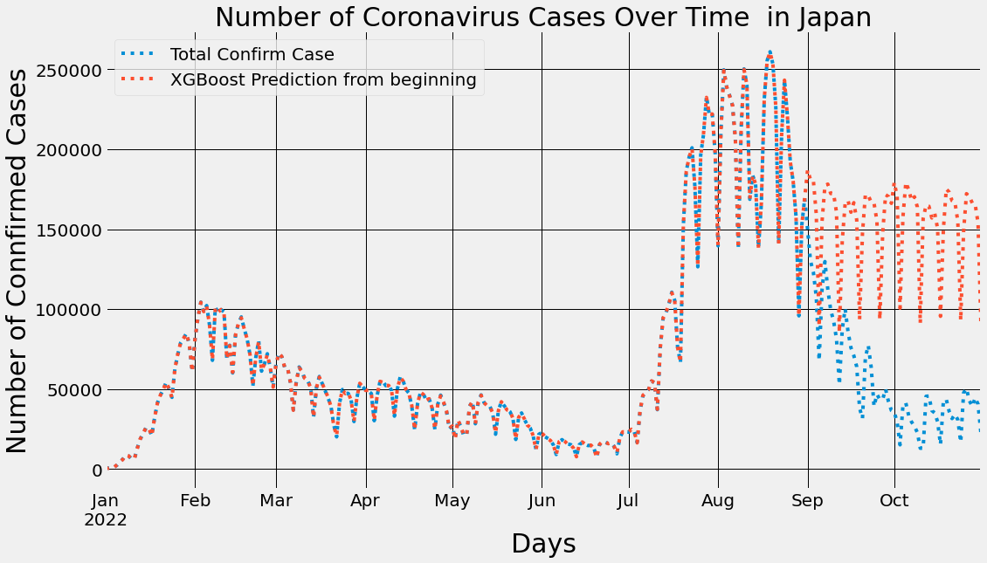
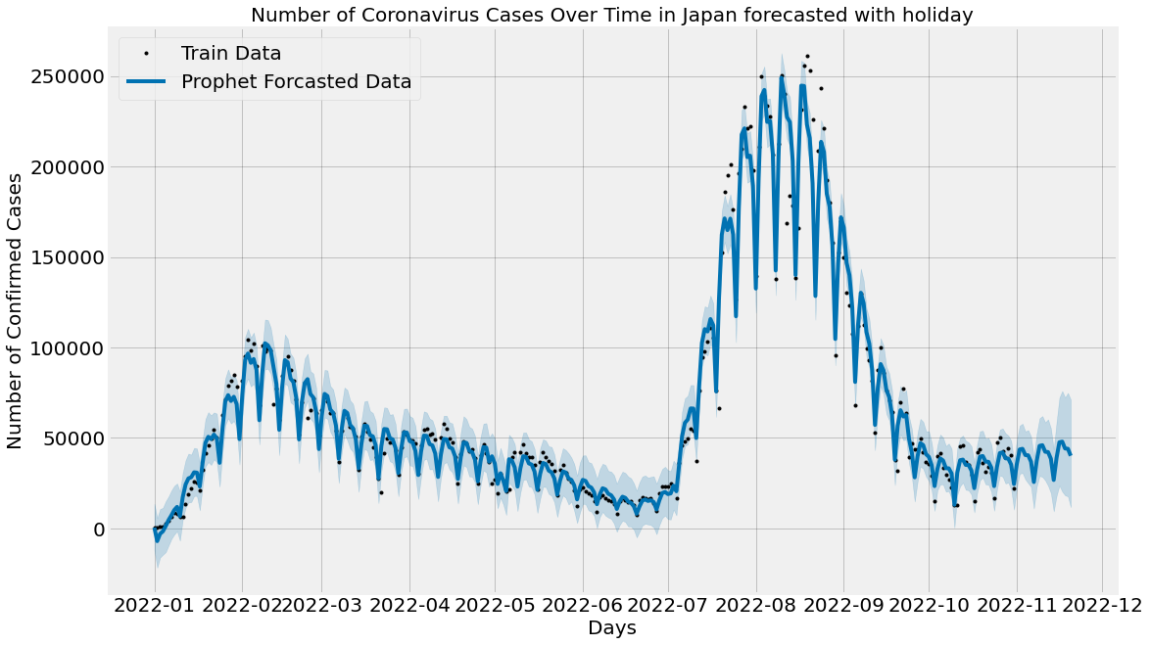
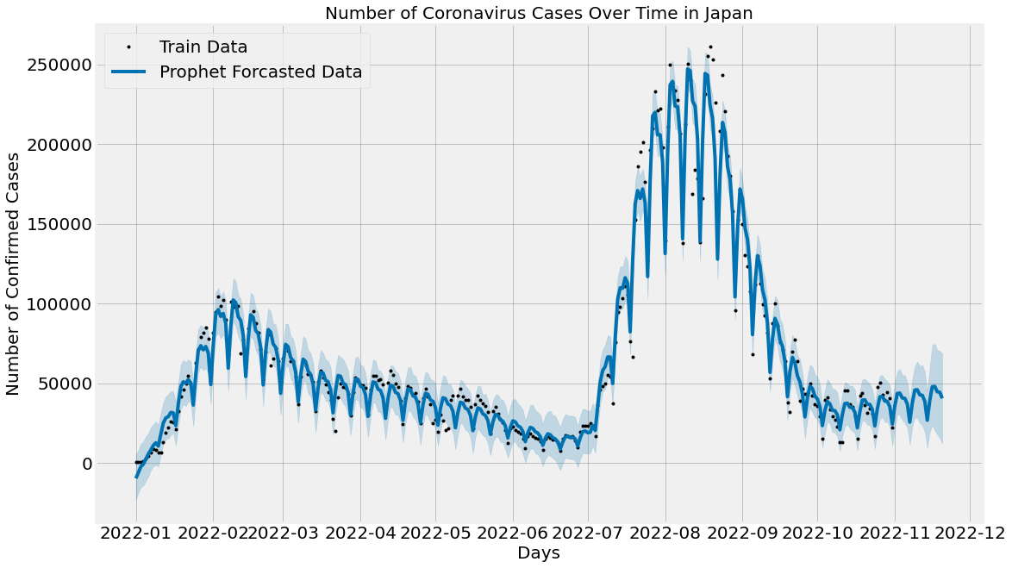
Result Analysis
(a) ARIMA
(b) Holt -Winters
(c) XGBoost
(d) Prophet (with Holiday)
(e) Prophet (without Holiday)
Fig 1: Graph of New Infected Cases Prediction using (a) ARIMA,(b) Holt-Winters, (c)XGBOOST (d) Prophet(with Holiday), and(e) Prophet(without Holiday) (JAPAN).

Slide 22
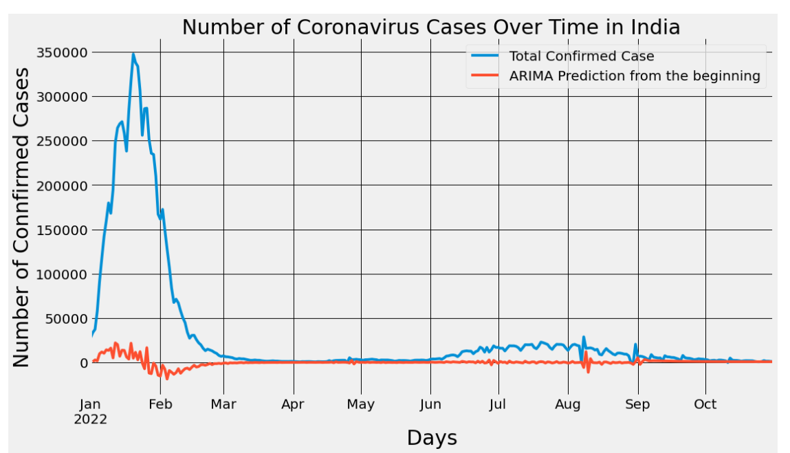
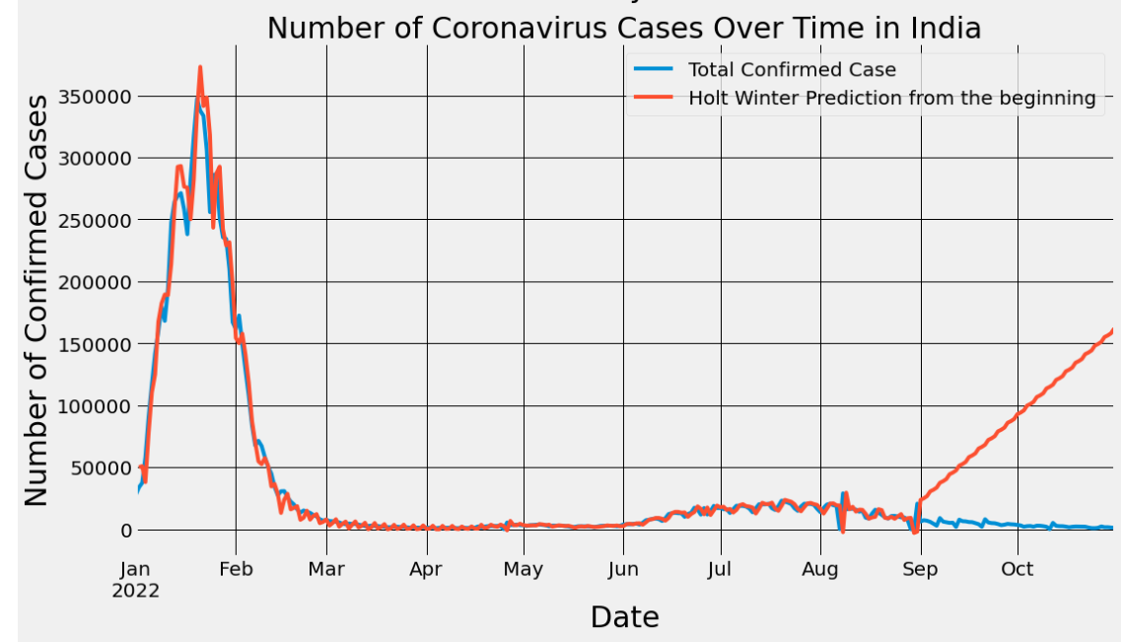
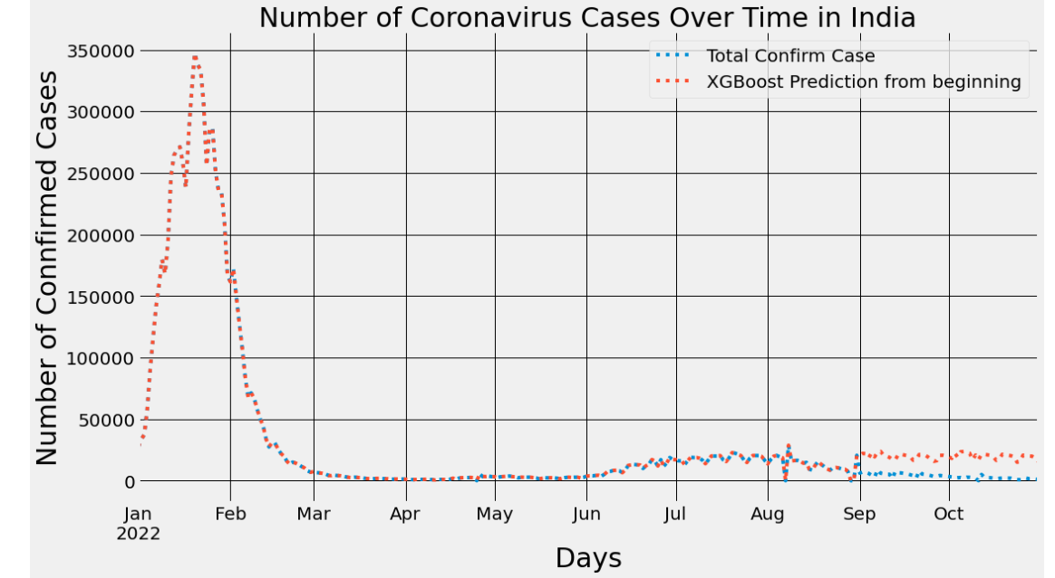
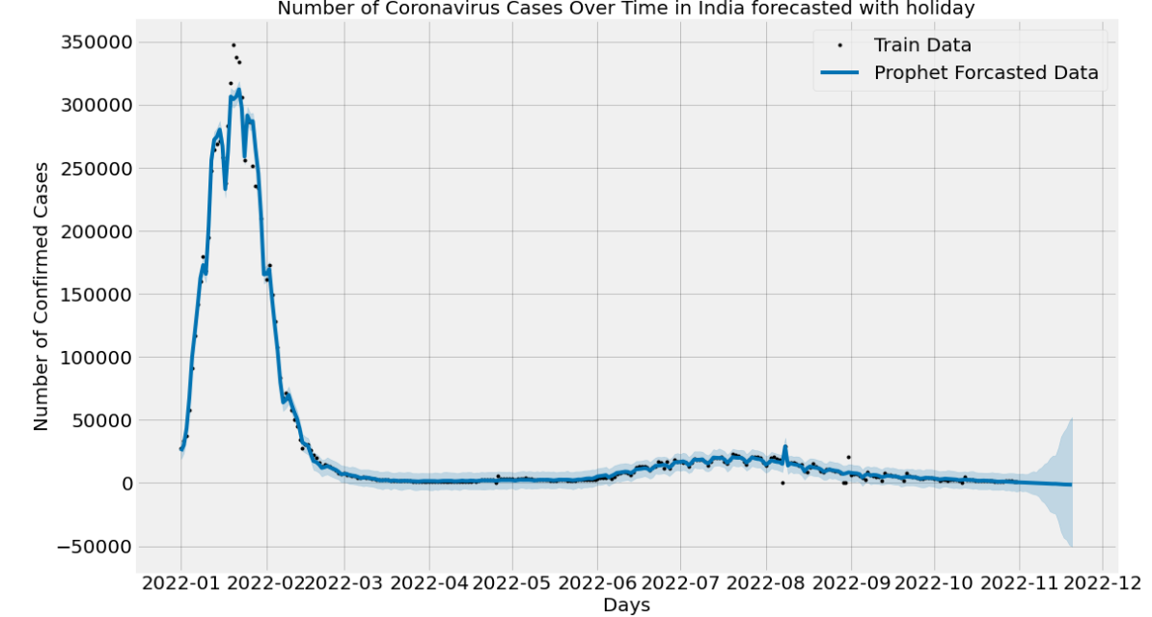
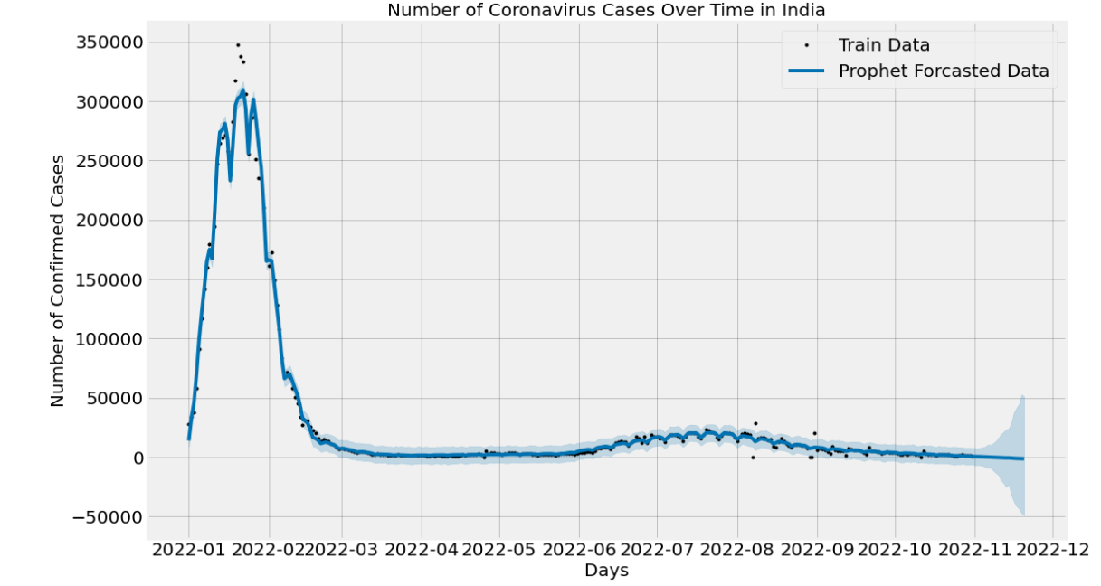
Result Analysis
(a) ARIMA
(b) Holt -Winters
(c) XGBoost
(d) Prophet (with Holiday)
(e) Prophet (without Holiday)
Fig 1: Graph of New Infected Cases Prediction using (a) ARIMA,(b) Holt-Winters, (c)XGBOOST (d) Prophet(with Holiday), and (e) Prophet(without Holiday) (INDIA).

Slide 23
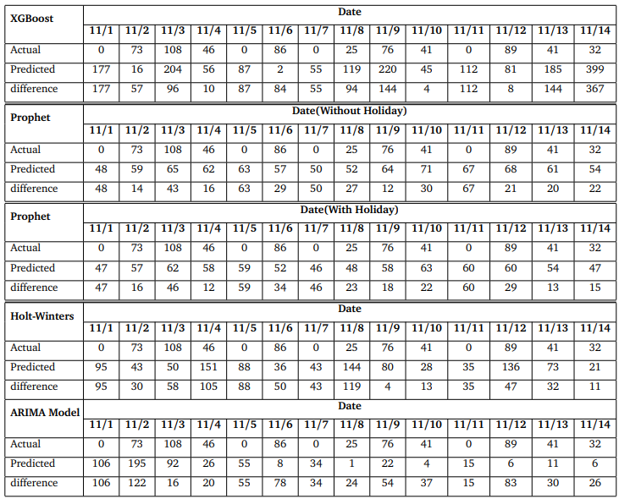
Result Analysis
Table 1:New infected confirm cases prediction by time series Model for the upcoming 14 days(PAKISTAN).

Slide 24
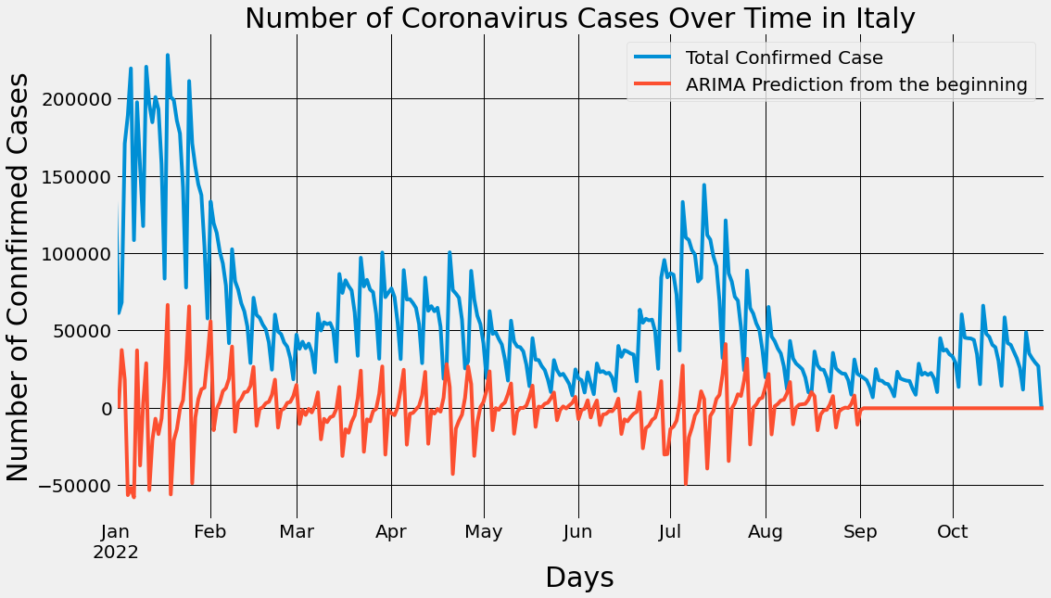
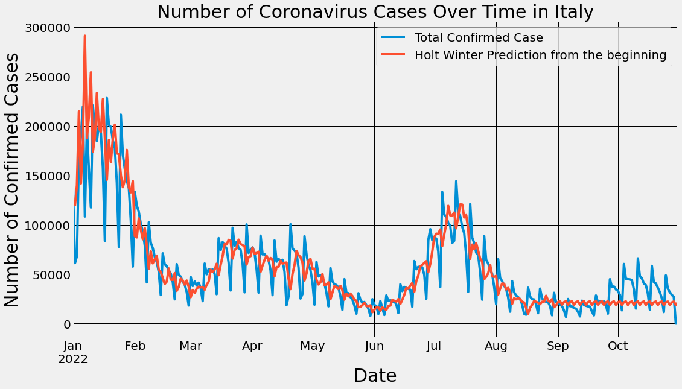
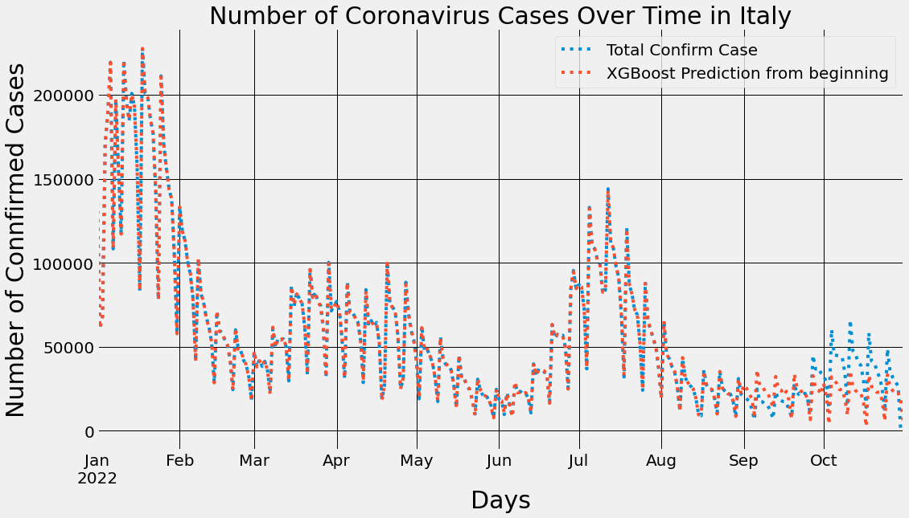
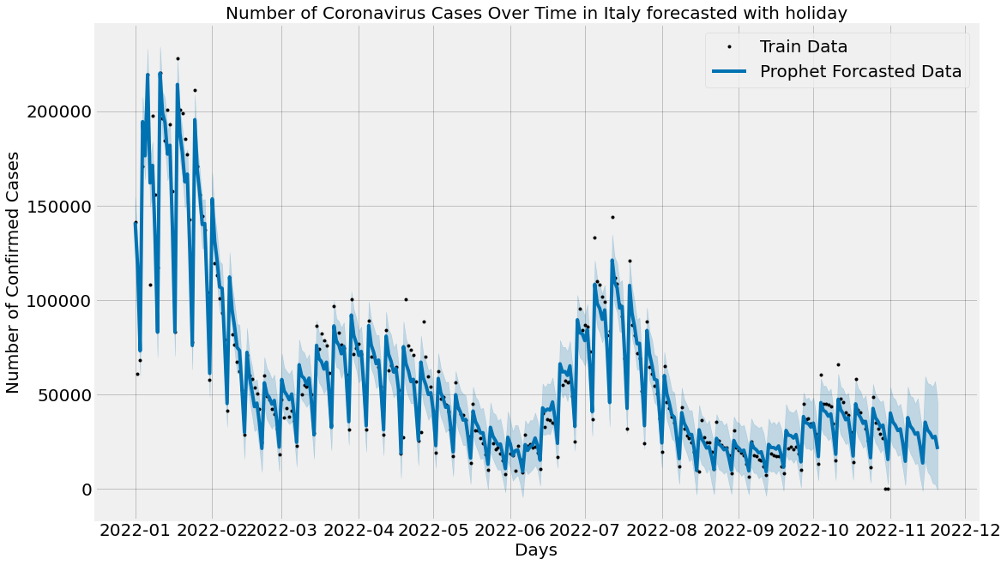
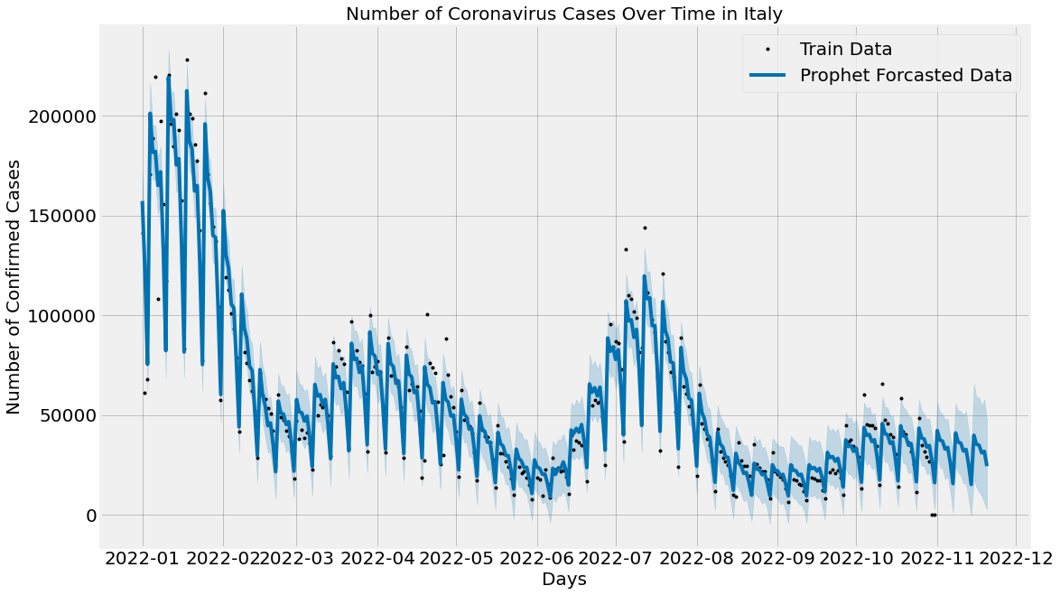
Result Analysis
(a) ARIMA
(b) Holt -Winters
(c) XGBoost
(d) Prophet (with Holiday)
(e) Prophet (without Holiday)
Fig 1: Graph of New Infected Cases Prediction using (a) ARIMA,(b) Holt-Winters, (c)XGBOOST (d) Prophet(with Holiday), and(e) Prophet(without Holiday) (ITALY).

Slide 25
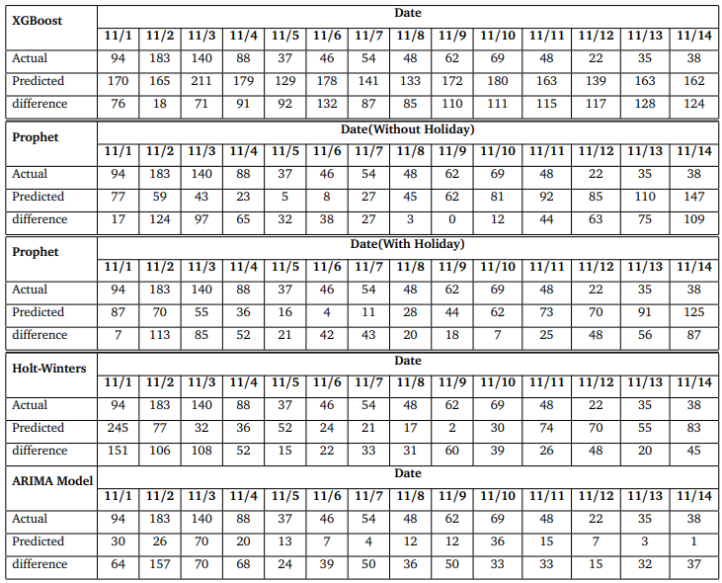
Result Analysis
Table 1:New infected confirm cases prediction by time series Model for the upcoming 14 days(BANGLADESH).

Slide 26
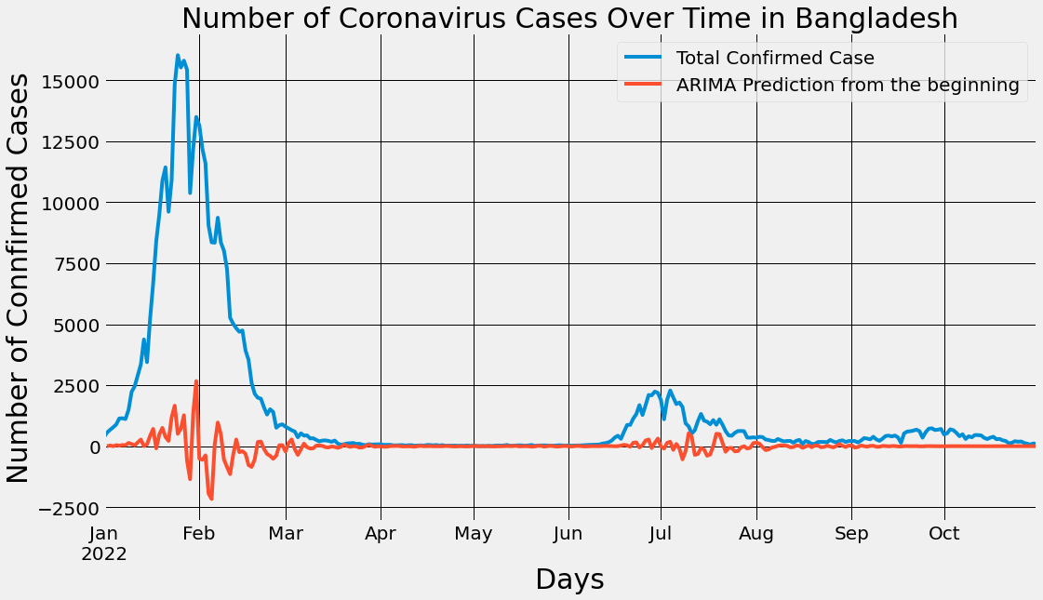
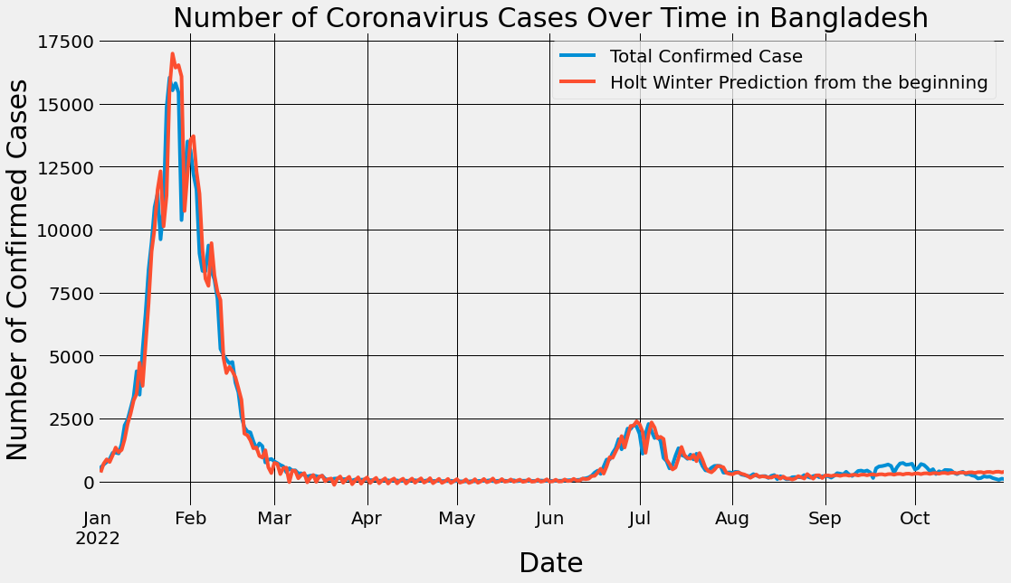
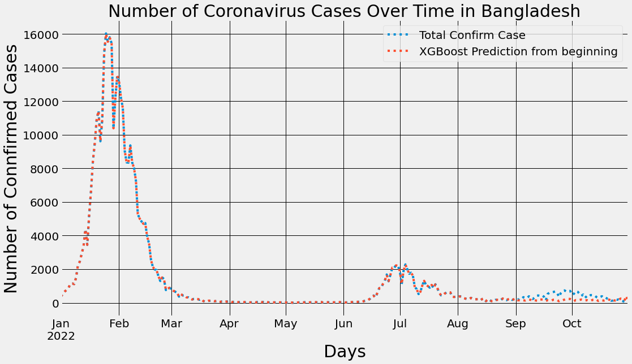
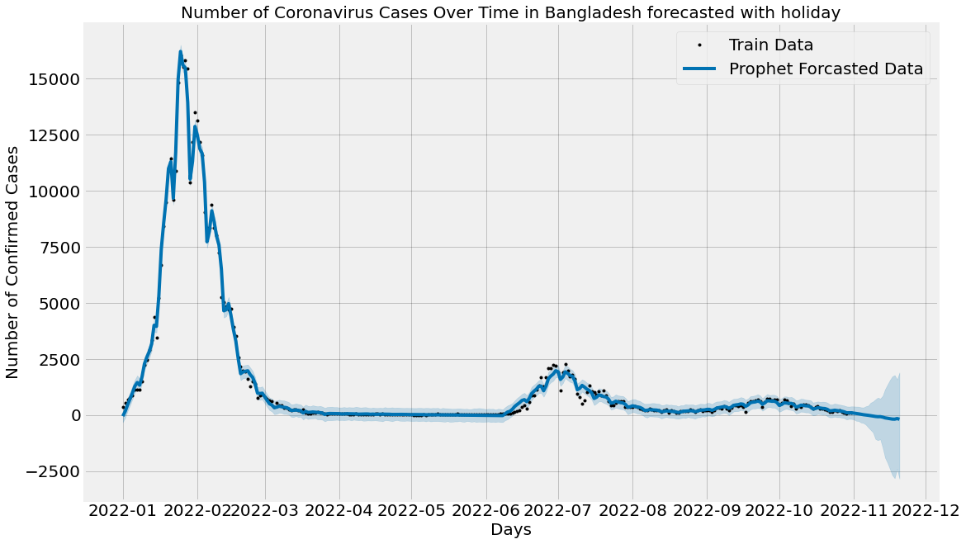
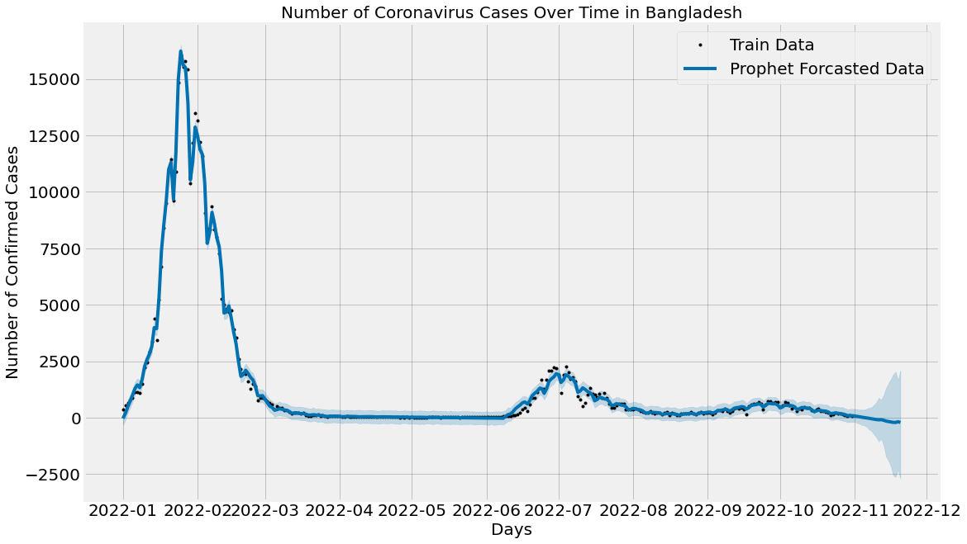
Result Analysis
(a) ARIMA
(b) Holt -Winters
(c) XGBoost
(d) Prophet (with Holiday)
(e) Prophet (without Holiday)
Fig 1: Graph of New Infected Cases Prediction using (a) ARIMA,(b) Holt-Winters, (c)XGBOOST (d) Prophet(with Holiday), and(e) Prophet(without Holiday) (BANGLADESH).

Slide 27
Result Analysis
(a) ARIMA
(b) Holt -Winters
(c) XGBoost
(d) Prophet (with Holiday)
(e) Prophet (without Holiday)
Fig 1: Graph of New Infected Cases Prediction using (a) ARIMA,(b) Holt-Winters, (c)XGBOOST (d) Prophet(with Holiday), and(e) Prophet(without Holiday) (GERMANY).

Slide 28
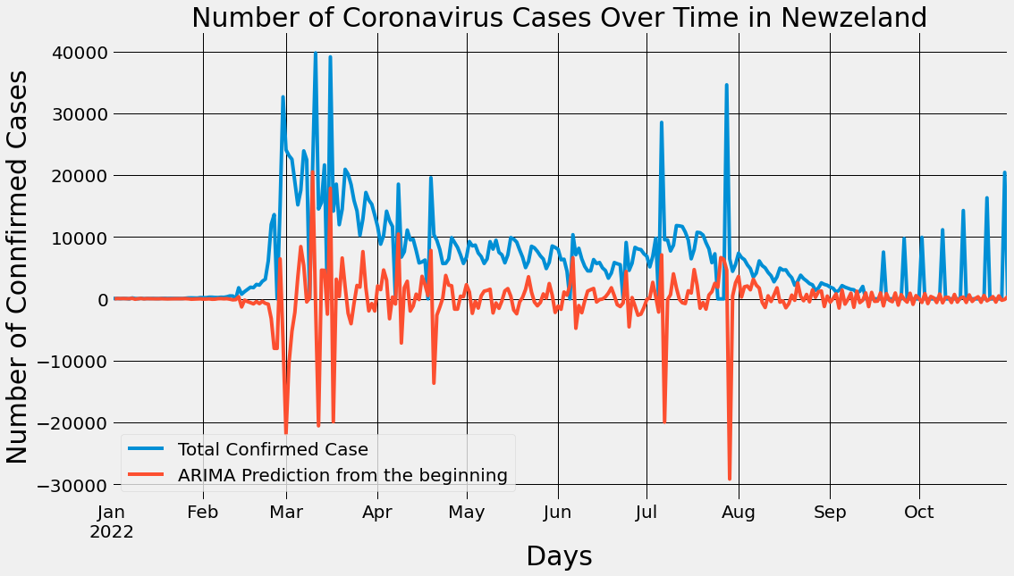
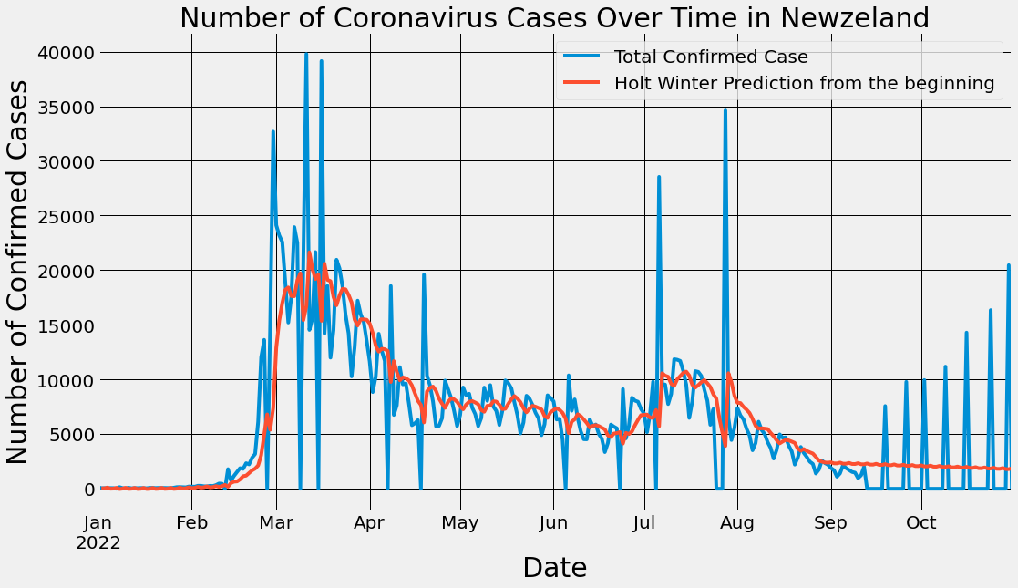
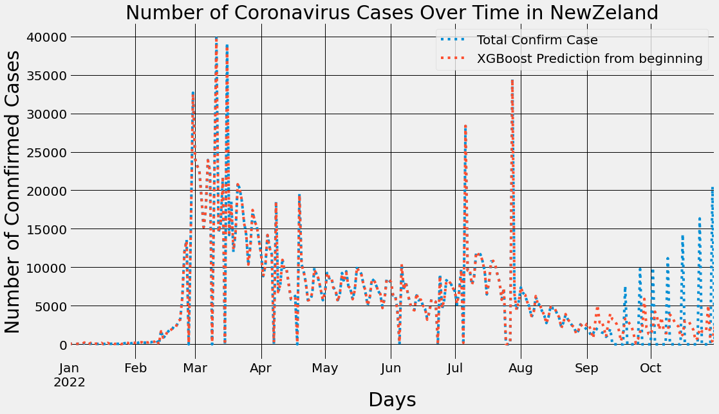
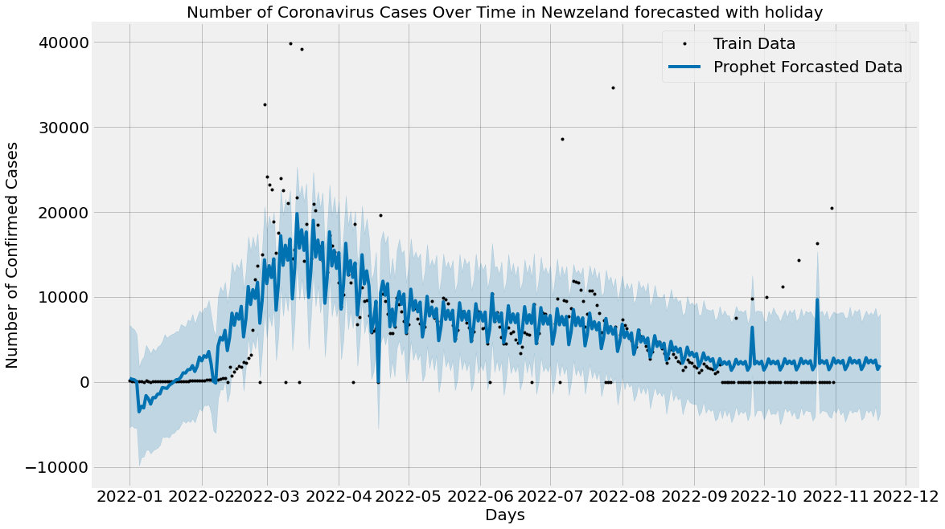
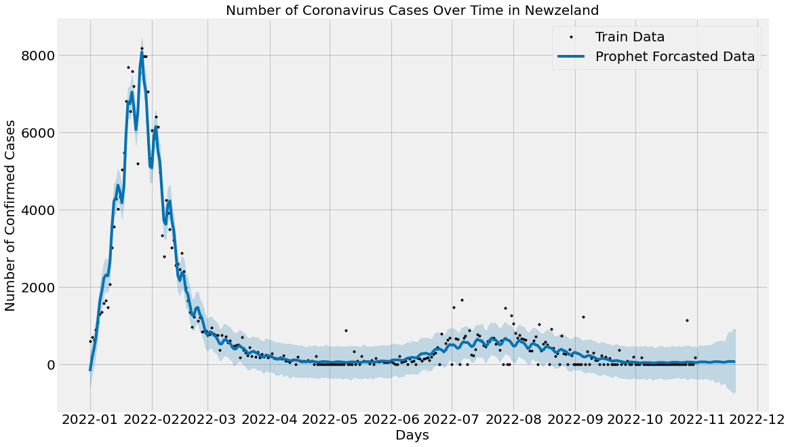
Result Analysis
(a) ARIMA
(b) Holt -Winters
(c) XGBoost
(d) Prophet (with Holiday)
(e) Prophet (without Holiday)
Fig 1: Graph of New Infected Cases Prediction using (a) ARIMA,(b) Holt-Winters, (c)XGBOOST (d) Prophet(with Holiday), and(e) Prophet(without Holiday) (NEW ZEALAND).

Slide 29
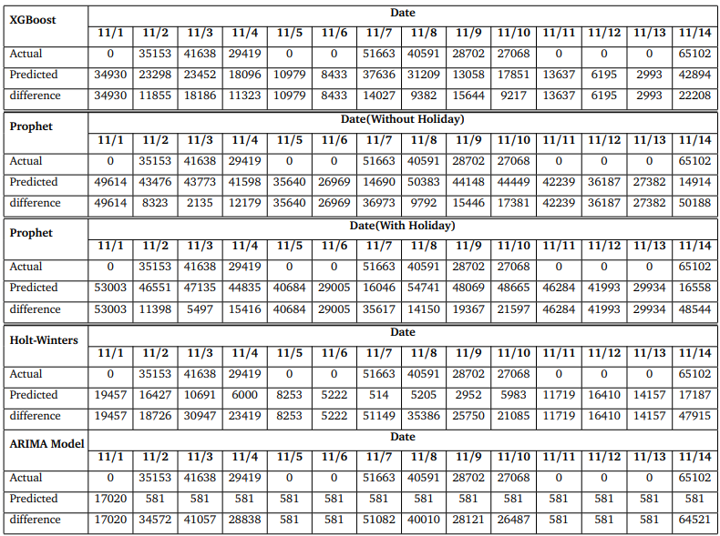
Result Analysis
Table 1:New infected confirm cases prediction by time series Model for the upcoming 14 days(FRANCE).

Slide 30
Summary
JAPAN:
Facebook Prophet outperforms all other models
XGBoost performs the worst
INDIA:
Facebook Prophet performs better
Holt-Winters is the weakest performer
PAKISTAN:
ARIMA and XGBoost outperform all other models
Holt-Winters is the weakest performer
ITALY:
Facebook Prophet with holiday impact and XGBoost model produces good performance
Holt-Winters produces a poor result.

Slide 31
Summary
BANGLADESH:
Facebook Prophet with holiday impact and Holt-winters outperform all other models
Facebook Prophet with no holiday impact produces poor results
GERMANY:
ARIMA and Facebook Prophet outperform all other models
Holt-Winters produces similar results
NEW ZEALAND:
Facebook with holiday impact and ARIMA produce good performance
XGBoost is the weakest model
FRANCE:
XGBoost and Holt-winters outperform all other models
Facebook Prophet with and without holiday impact produces similar results.

Slide 32
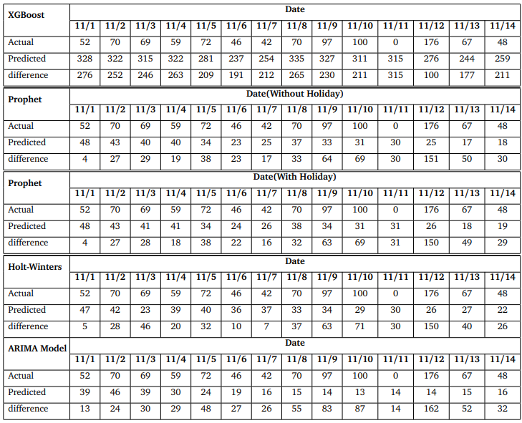
Result Analysis (Death Cases)
Table 1:New death cases prediction by time series Model for the upcoming 14 days(JAPAN).

Slide 33
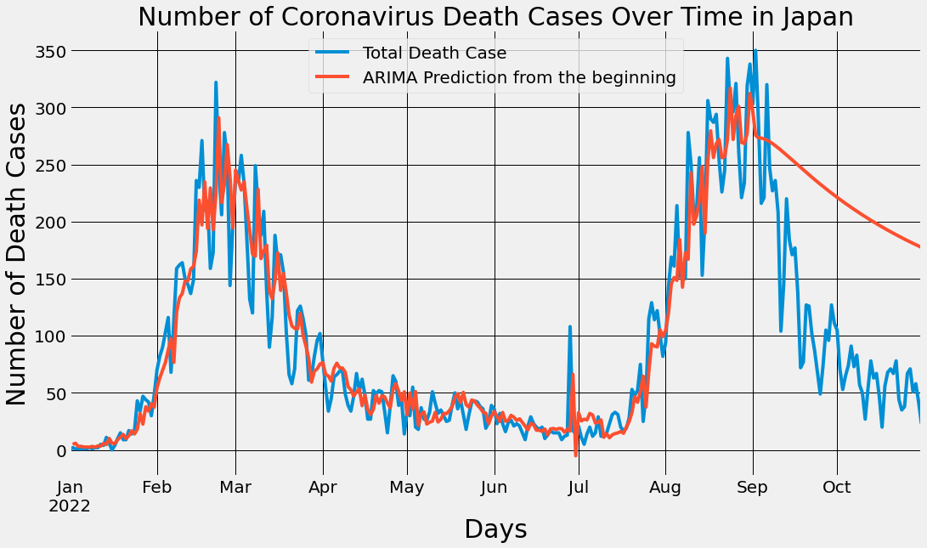
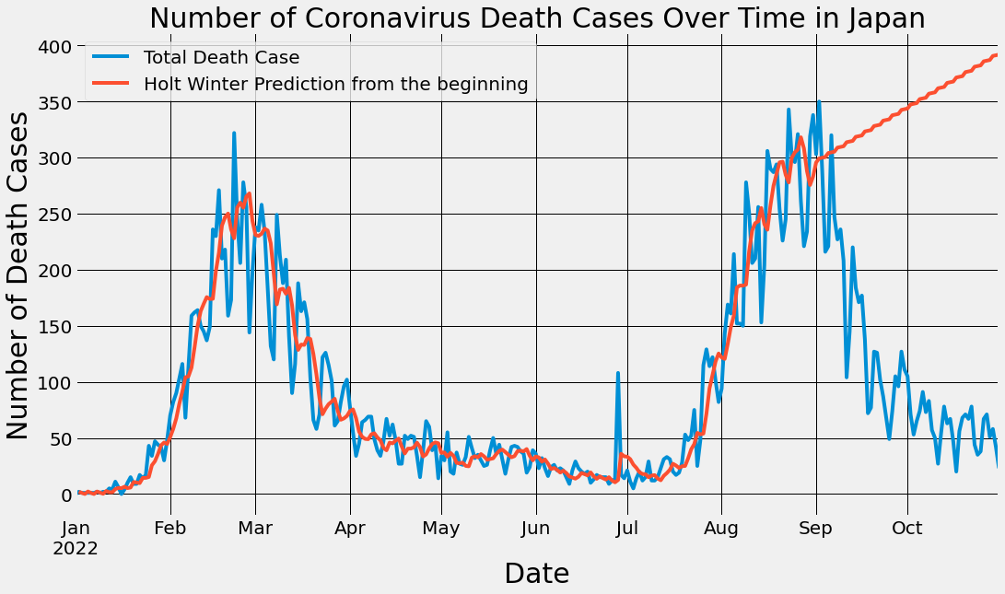
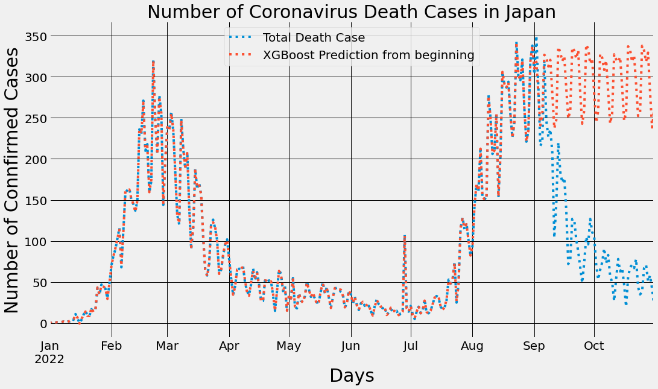
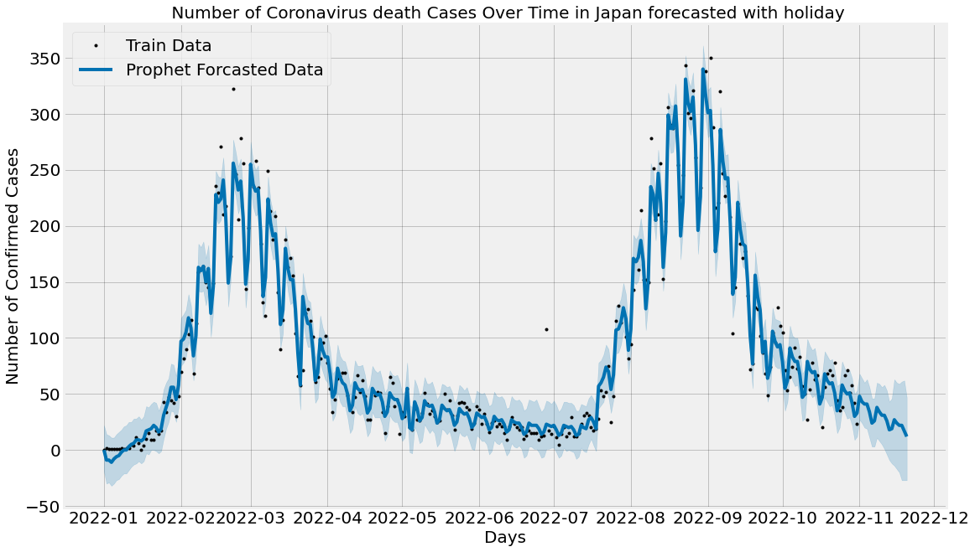
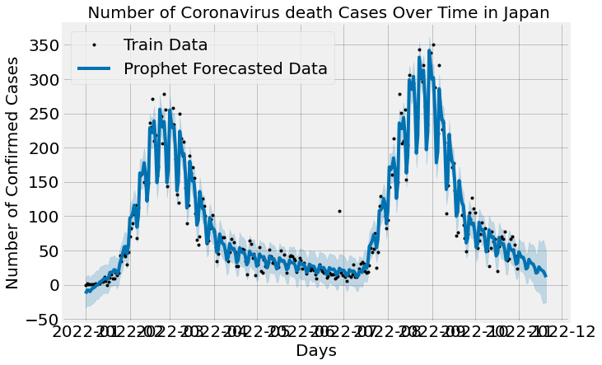
Result Analysis
(a) ARIMA
(b) Holt -Winters
(c) XGBoost
(d) Prophet (with Holiday)
(e) Prophet (without Holiday)
Fig 1: Graph of death Cases Prediction using (a) ARIMA,(b) Holt-Winters, (c)XGBOOST (d) Prophet(with Holiday), and(e) Prophet(without Holiday) (JAPAN).

Slide 34
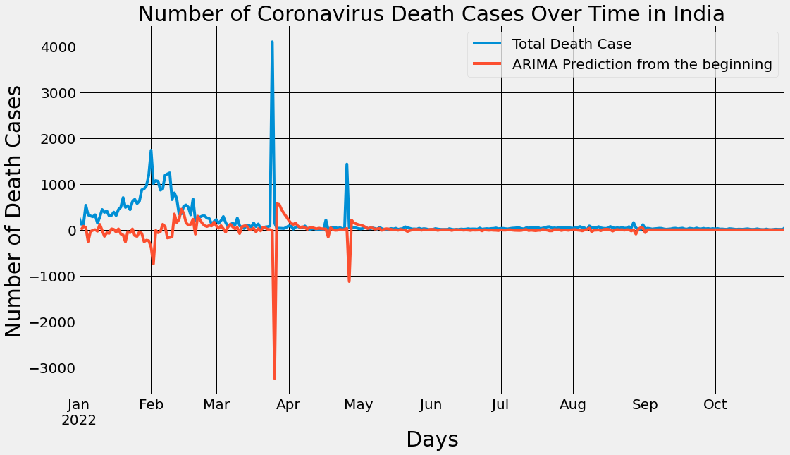
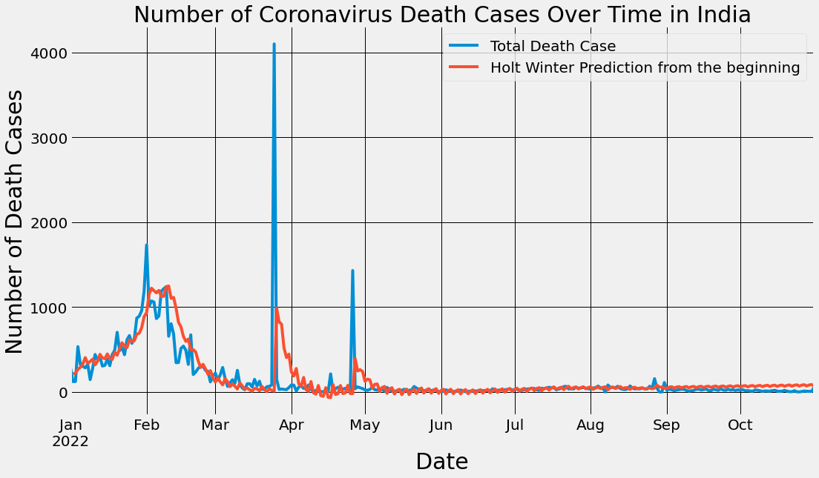
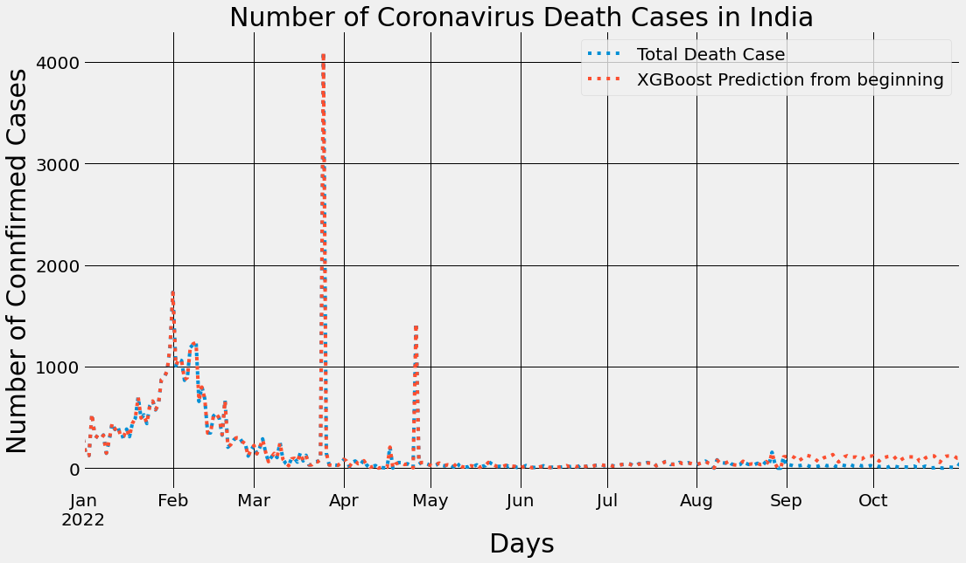
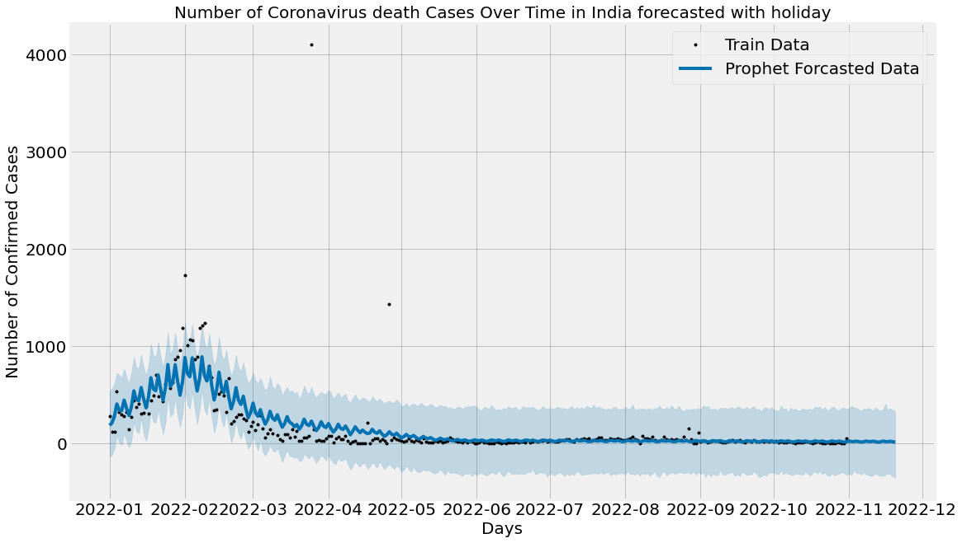
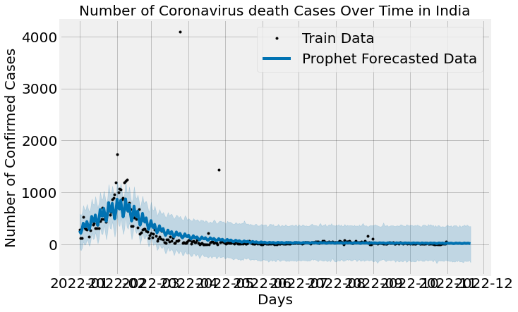
Result Analysis
(a) ARIMA
(b) Holt -Winters
(c) XGBoost
(d) Prophet (with Holiday)
(e) Prophet (without Holiday)
Fig 1: Graph of death Cases Prediction using (a) ARIMA,(b) Holt-Winters, (c)XGBOOST (d) Prophet(with Holiday), and(e) Prophet(without Holiday) (INDIA).

Slide 35
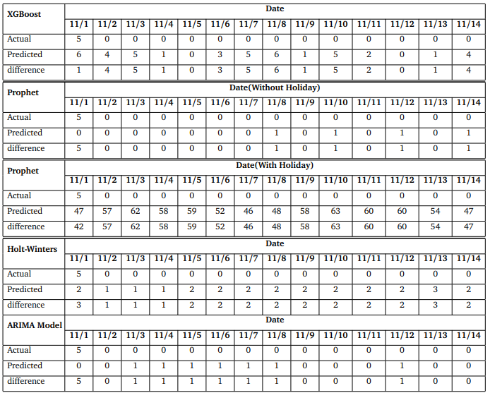
Result Analysis
Table 1:New death cases prediction by time series Model for the upcoming 14 days(PAKISTAN).

Slide 36
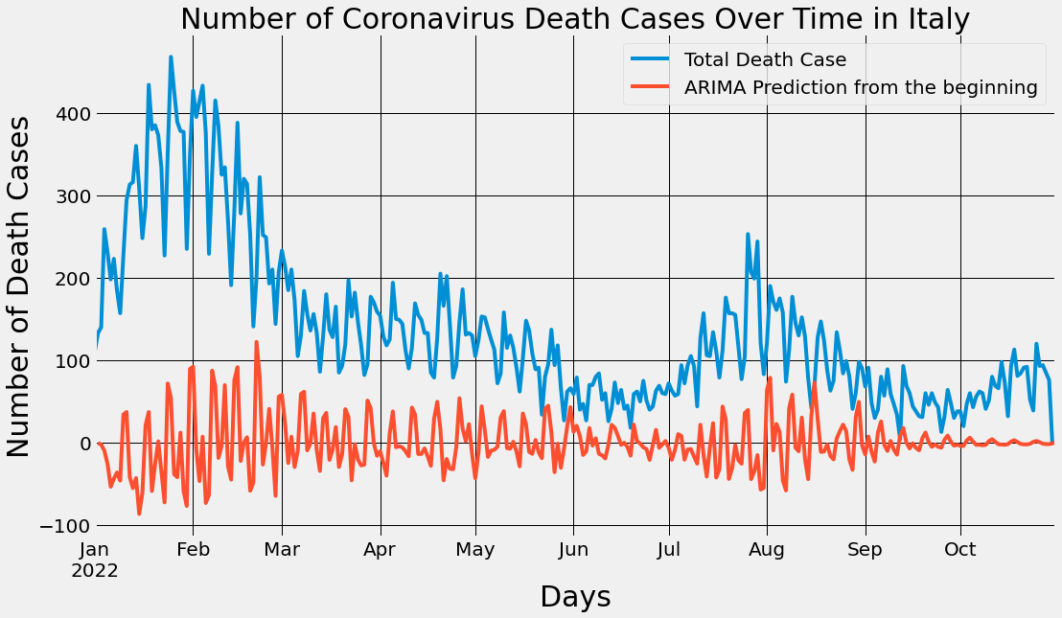
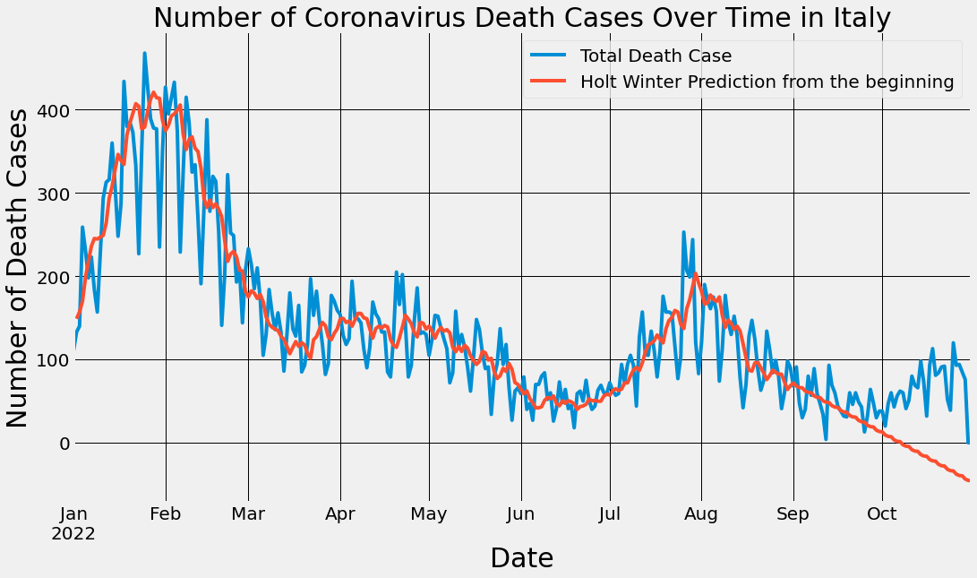
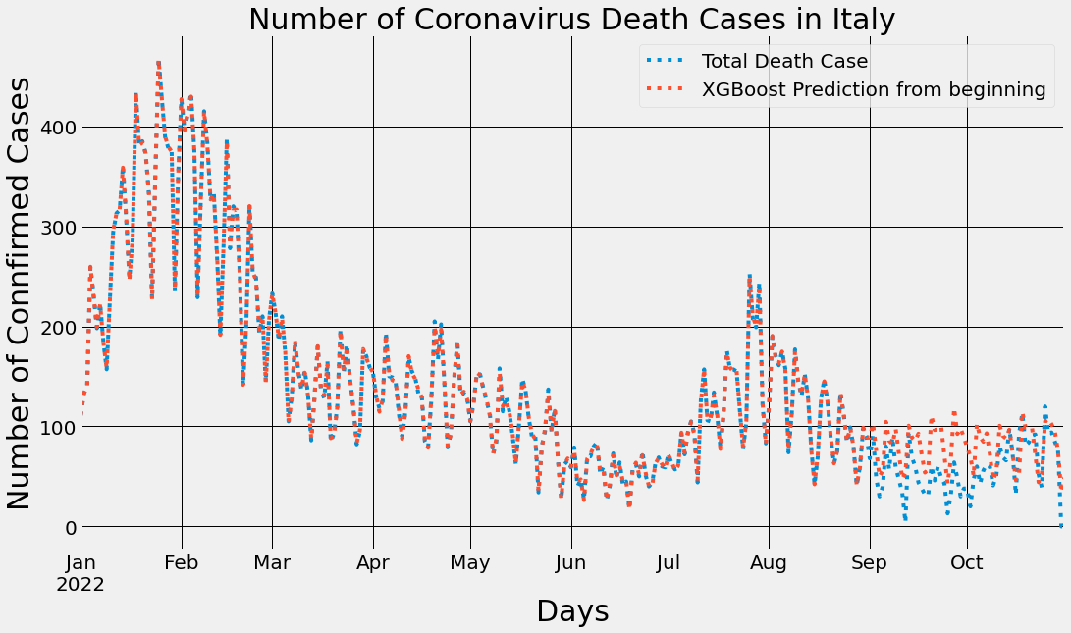
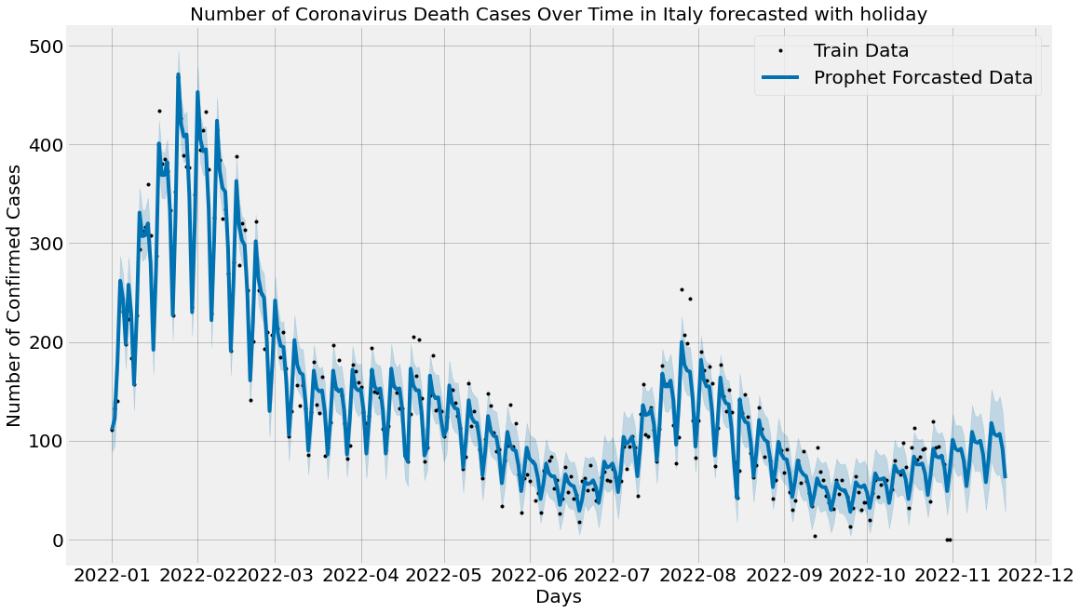
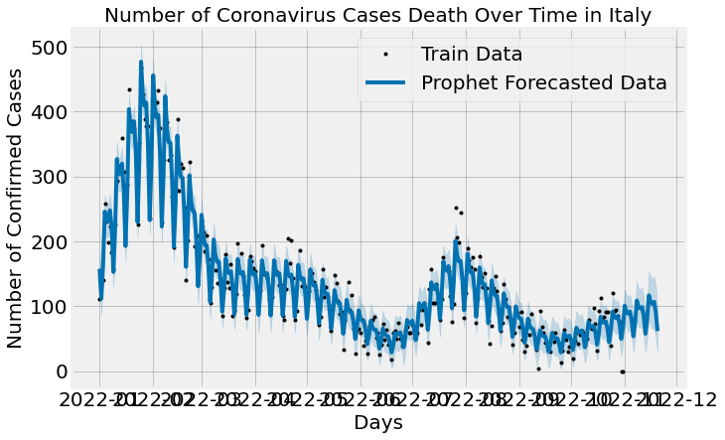
Result Analysis
(a) ARIMA
(b) Holt -Winters
(c) XGBoost
(d) Prophet (with Holiday)
(e) Prophet (without Holiday)
Fig 1: Graph of New death Cases Prediction using (a) ARIMA,(b) Holt-Winters, (c)XGBOOST (d) Prophet(with Holiday), and(e) Prophet(without Holiday) (ITALY).

Slide 37
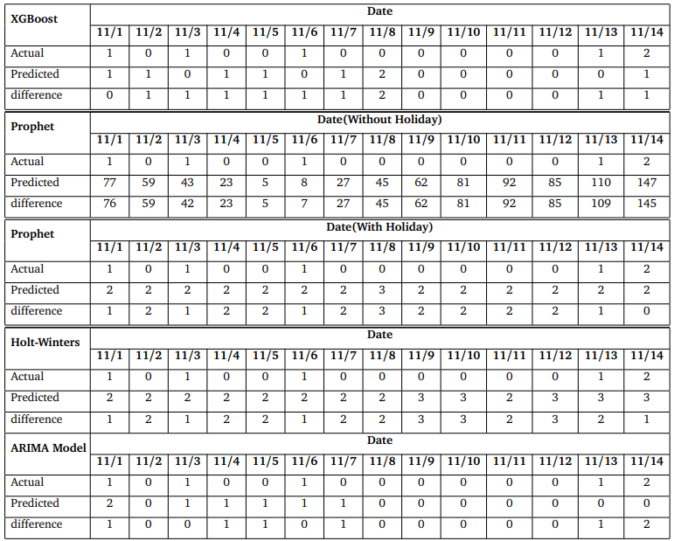
Result Analysis
Table 1:New death cases prediction by time series Model for the upcoming 14 days(BANGLADESH).

Slide 38
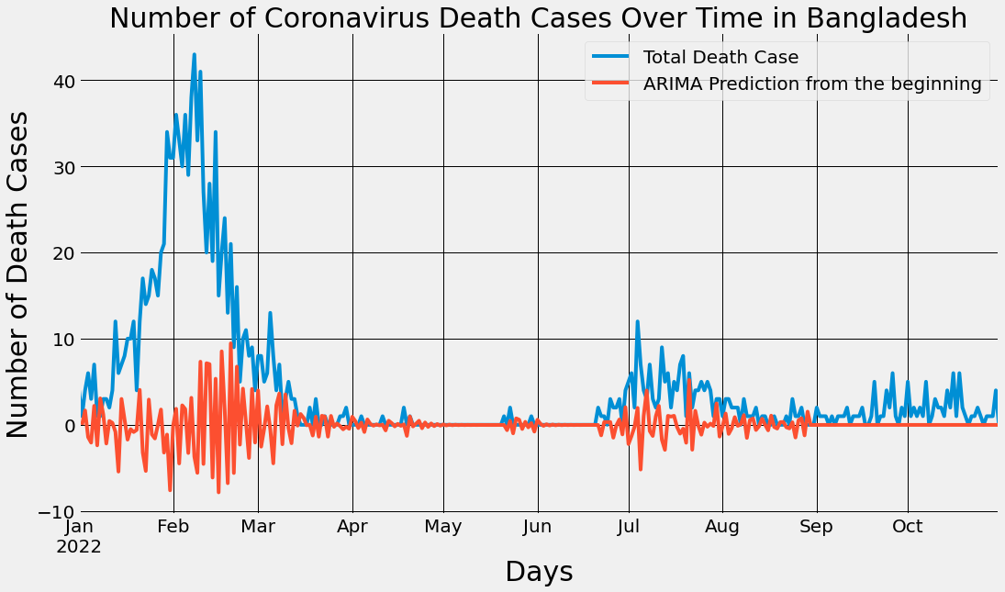




Result Analysis
(a) ARIMA
(b) Holt -Winters
(c) XGBoost
(d) Prophet (with Holiday)
(e) Prophet (without Holiday)
Fig 1: Graph of New Death Cases Prediction using (a) ARIMA,(b) Holt-Winters, (c)XGBOOST (d) Prophet(with Holiday), and(e) Prophet(without Holiday) (BANGLADESH).

Slide 39





Result Analysis
(a) ARIMA
(b) Holt-Winters
(c) XGBoost
(d) Prophet (with Holiday)
(e) Prophet (without Holiday)
Fig 1: Graph of New Death Cases Prediction using (a) ARIMA,(b) Holt-Winters, (c)XGBOOST (d) Prophet(with Holiday), and(e) Prophet(without Holiday) (GERMANY).

Slide 40





Result Analysis
(a) ARIMA
(b) Holt -Winters
(c) XGBoost
(d) Prophet (with Holiday)
(e) Prophet (without Holiday)
Fig 1: Graph of New Death Cases Prediction using (a) ARIMA,(b) Holt-Winters, (c)XGBOOST (d) Prophet(with Holiday), and(e) Prophet(without Holiday) (NEW ZEALAND).

Slide 41

Result Analysis
Table 1:New death cases prediction by time series Model for the upcoming 14 days(FRANCE).

Slide 42
Summary
JAPAN:
Facebook Prophet outperforms all other models
Holt-Winters performs the worst
INDIA:
ARIMA performs better
Facebook Prophet is the weakest performer
PAKISTAN:
ARIMA and XGBoost outperform all other models
Facebook Prophet with holiday impact is the weakest performer
ITALY:
Facebook Prophet model produces good performance
Holt-Winters produces a poor result.

Slide 43
Summary
BANGLADESH:
XGBoost and ARIMA outperform all other models
Holt-winters produces poor results
GERMANY:
Facebook Prophet outperform all other models
ARIMA produces similar results
NEW ZEALAND:
Facebook Prophet and ARIMA produce good performance
XGBoost is the weakest model
FRANCE:
XGBoost and Holt-winters outperform all other models
ARIMA produces poor results.

Slide 44


Future Work
To anticipate recovery cases
Deep learning-based analysis
1
♛
2
Impact of various weather parameters
3

Slide 45

Conclusion
COVID19 has a significant impact on health, education, the economy, jobs, and a variety of other areas
The outcome results helps the policymakers to develop their future plans
Machine Learning approaches are helping to analyze and predict the pandemic
Build such strong models to help mankind from this type of tragic attack

Slide 46

References
1. Al-Qaness, M. A., Saba, A. I., Elsheikh, A. H., Abd Elaziz, M., Ibrahim, R. A., Lu, S., ...
Ewees, A. A. (2021). Efficient artificial intelligence forecasting models for COVID-19 outbreak in
Russia and Brazil. Process Safety and Environmental Protection, 149, 399-409.
2. Abbasimehr, Hossein, and Reza Paki. ”Prediction of COVID-19 confirmed cases combining
deep learning methods and Bayesian optimization.” Chaos, Solitons Fractals 142 (2021): 110511.
3. Prasanth, S., Singh, U., Kumar, A., Tikkiwal, V. A., Chong, P. H. (2021). Forecasting spread of
COVID-19 using google trends: A hybrid GWO-deep learning approach. Chaos, Solitons Fractals,
142, 110336.
4. Samrin, N. A., Suzan, M., Hasan, M., Hossain, M., Mollah, M. S. H., Haque, M. (2022).
Analysis of COVID-19 Trends in Bangladesh: A Machine Learning Analysis. In AI and IoT for
Sustainable Development in Emerging Countries (pp. 611-625). Springer, Cham.
5. Tuli, Shreshth, Shikhar Tuli, Rakesh Tuli, and Sukhpal Singh Gill. ”Predicting the growth and
trend of COVID-19 pandemic using machine learning and cloud computing.” Internet of Things 11
(2020): 100222.

Slide 47
6. Rustam, Furqan, Aijaz Ahmad Reshi, Arif Mehmood, Saleem Ullah, Byung-Won On, Waqar
Aslam, and Gyu Sang Choi. ”COVID-19 future forecasting using supervised machine learning
models.” IEEE access 8 (2020): 101489-101499.
7. Leon, M. I., Iqbal, M. I., Azim, S. M., Al Mamun, K. A. (2021, February). Predicting
COVID-19 infections and deaths in Bangladesh using Machine Learning Algorithms. In 2021
International Conference on Information and Communication Technology for Sustainable Development
(ICICT4SD) (pp. 70-75). IEEE.
8. Khakharia, A., Shah, V., Jain, S., Shah, J., Tiwari, A., Daphal, P., ... Mehendale, N. (2021).
Outbreak prediction of COVID-19 for dense and populated countries using machine learning. Annals
of Data Science, 8(1), 1-19.
9. Bhadana, V., Jalal, A. S., Pathak, P. (2020, December). A comparative study of machine
learning models for COVID-19 prediction in India. In 2020 IEEE 4th Conference on Information
Communication Technology (CICT) (pp. 1-7). IEEE.

Slide 48
10. Tamhane, Richa, and Sumeet Mulge. ”Prediction of COVID-19 outbreak using machine learning.”
International Research Journal of Engineering and Technology (IRJET) 7, no. 5 (2020).
11. Abdullha, A., Abujar, S. (2020, November). COVID-19: Data Analysis and the situation
Prediction Using Machine Learning Based on Bangladesh perspective. In 2020 15th International
Joint Symposium on Artificial Intelligence and Natural Language Processing (iSAI-NLP) (pp. 1-8).
IEEE.
12. Prakash, Kolla Bhanu, S. Sagar Imambi, Mohammed Ismail, T. Pavan Kumar, and Y. N.
Pawan. ”Analysis, prediction and evaluation of covid-19 datasets using machine learning algorithms.”
International Journal 8, no. 5 (2020).
13. Masum, A. K. M., Khushbu, S. A., Keya, M., Abujar, S., Hossain, S. A. (2020). COVID-19
in Bangladesh: a deeper outlook into the forecast with prediction of upcoming per day cases using
time series. Procedia Computer Science, 178, 291-300.

Slide 49
14. Muhammad, L. J., Algehyne, E. A., Usman, S. S., Ahmad, A., Chakraborty, C., Mohammed,
I. A. (2021). Supervised machine learning models for prediction of COVID-19 infection using epidemiology
dataset. SN computer science, 2(1), 1-13.
15. Alzahrani, S. I., Aljamaan, I. A., Al-Fakih, E. A. (2020). Forecasting the spread of the
COVID-19 pandemic in Saudi Arabia using ARIMA prediction model under current public health
interventions. Journal of infection and public health, 13(7), 914-919.
16. Gupta, M., Jain, R., Arora, S., Gupta, A., Javed Awan, M., Chaudhary, G., Nobanee, H.
(2021). AI-enabled COVID-19 outbreak analysis and prediction: Indian states vs. union territories.
Gupta, M., Jain, R., Arora, S., Gupta, A., Awan, MJ, Chaudhary, G., Nobanee, H.(2021).
AI-Enabled COVID-19 Outbreak Analysis and Prediction: Indian States vs. Union Territories.
Cmc-Computers Materials Continua, 67(1), 933-950.
17. Wibowo, F. W. (2021, February). Prediction modelling of COVID-19 outbreak in Indonesia
using a logistic regression model. In Journal of Physics: Conference Series (Vol. 1803, No. 1, p.
012015). IOP Publishing.

Slide 50
18. Saba, T., Abunadi, I., Shahzad, M. N., Khan, A. R. (2021). Machine learning techniques to
detect and forecast the daily total COVID-19 infected and deaths cases under different lockdown
types. Microscopy Research and Technique, 84(7), 1462-1474.
19. Akhtar, A., Akhtar, S., Bakhtawar, B., Kashif, A. A., Aziz, N., Javeid, M. S. (2021). COVID-
19 Detection from CBC using Machine Learning Techniques. International Journal of Technology,
Innovation and Management (IJTIM), 1(2), 65-78.
20. Sujath, R., Chatterjee, J. M., Hassanien, A. E. (2020). A machine learning forecasting model
for COVID-19 pandemic in India. Stochastic Environmental Research and Risk Assessment, 34(7),
959-972.

Slide 51





